Slide 1
Art of thinking and re-thinking
This is an academic course design to develop the ways of form (an informed) opinion, develop the arguments and cultivate thinking as an art

Slide 2
Philosophy of nothing. Why there is rather something than nothing? Trying to define the finite and infinite.
Anna Frątczak

Slide 3
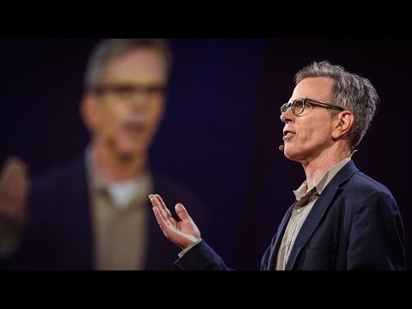
Jim Holt, an American philosopher, author and essayis. In 20123 he published „WHY DOES THE WORLD EXIST? An Existential Detective Story”

Slide 4
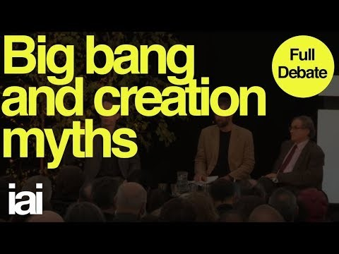
Watch Big Bang Creation Myths | Full Debate | Roger Penrose, Sean Carroll, Laura Mersini-Hougton

Slide 5
ASSIGNMENT
Watch the linked videos
Make a research on ancient/religoius cosmologies
3. Working with Your partner try to answear the following questions (You may Focus on one)
- How much do we know about the Universe?
- Why do we want to know the Universe?
- What is the diffrence between the Big Bang theory and a religoius creation myth?
- Put down Your conclusions
(Word, Times New Roman 12, 350 words) and send to fpfratczak@gmail.com by 10.04.2020
TAT.Kowalski.Nowak.1004 – this is how an exemplary title of Your e-mail should look like
If You have any questions contact me on FB.

