Slide 1
This is an academic course design to develop the ways of form (an informed) opinion, develop the arguments and cultivate thinking as an art
Art of thinking and re-thinking

Slide 2
So, who is the barbarian anyway?

Slide 3
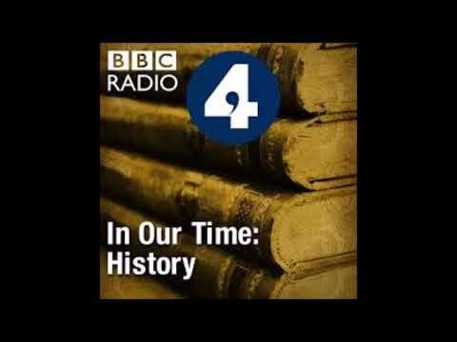
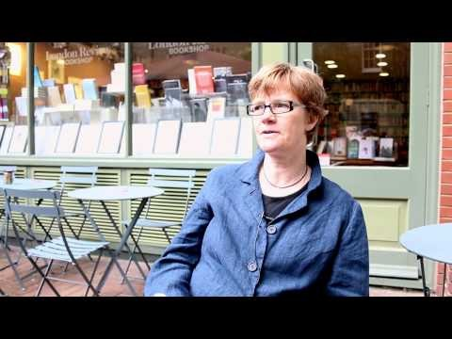
Podcasts and videos on Montaigne: watch and listen to:

Slide 4
Read the two following texts:
Michael de Montaigne, „Of Cannibals”
https://www.gutenberg.org/files/3600/3600-h/3600-h.htm#link2HCH0030
„Of Cruelty” (optional)
https://www.gutenberg.org/files/3600/3600-h/3600-h.htm#link2HCH0068
Judith Shklar, „Putting cruelty first”
https://www.dissentmagazine.org/wp-content/files_mf/1389811110d4Shklar.pdf

Slide 5
ASSIGNMENT nr 2
Working with Your partner(s) try to answear the following questions (You may focus on one)
- what is the modern use of the idea of ‚”a barbarian”?
- how is the idea of barbarity linked to the idea of cruelty?
- what is the modern „face” of cruelty, specifically in the political context? What are the advantages of avoiding/preventing cruelty
- Put down Your conclusions
(Word, Times New Roman 12, 350 words) and send to fpfratczak@gmail.com by 18.05.2020
TAT.Kowalski.Nowak.1805– this is how an exemplary title of Your e-mail should look like . Rembember to attach the essay in a word file and give it the same title!
If You have any questions contact me on FB.

