Slide 1
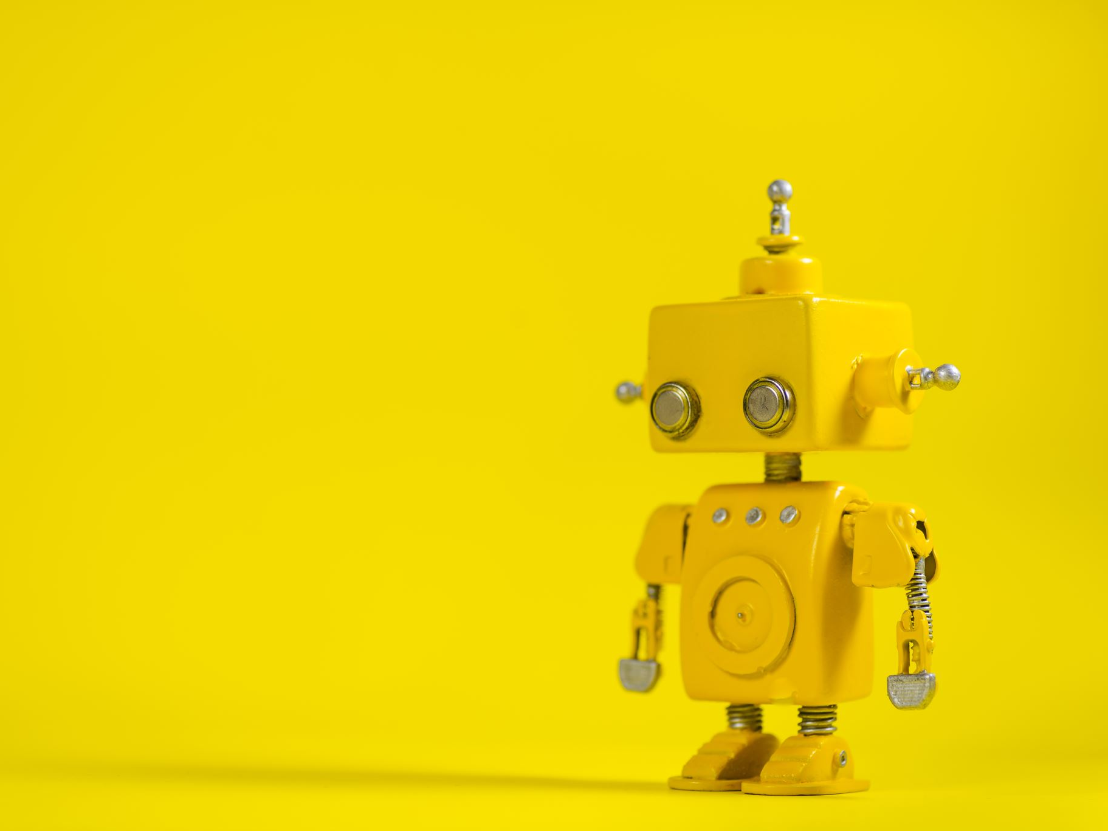
Popular culture: The Other, Robot, Artificial Intelligence

Slide 2
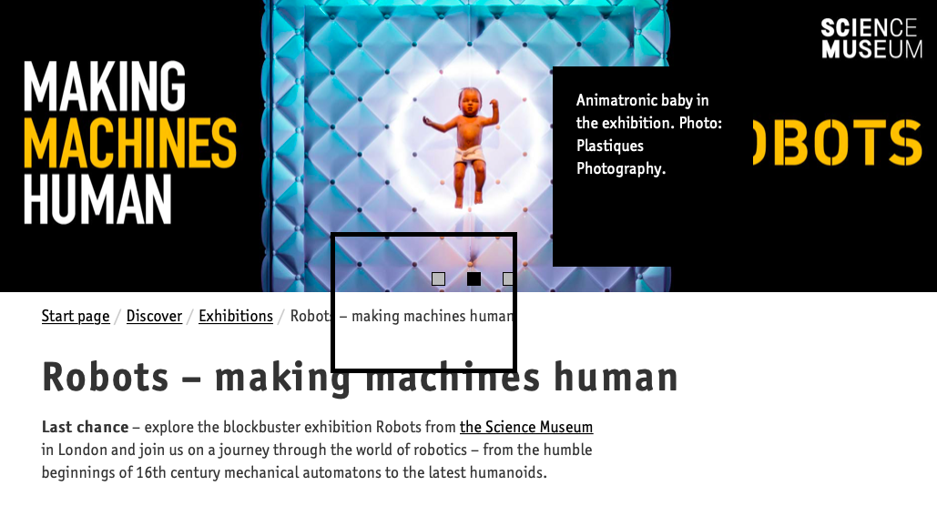
Animistic tradition Prometheus is a Titan, culture hero, and trickster figure who is credited with the creation of humanity from clay…. GOLEM https://www.youtube.com/watch?v=UCfOH_RKgmU Frankenstein's Monster
Mechanic tradition/science
Techniska Museet 2019/2020 (from The Science Museum, London)

Slide 3
Metropolis by Fritz Lang
Enlightenment (Immanuel Kant)
Reason
Technology
The body under control (medicine, eugenic theories)
The belief of human being being replaceable
(trains, photography, opticians, cars, phone)

Slide 4
Metropolis analyzing fragment

Slide 5
Black mirror case

