Slide 1
Popular Culture
Pop… looking for a definition
(The Art of Thinking and Re-Thinking)

Slide 2
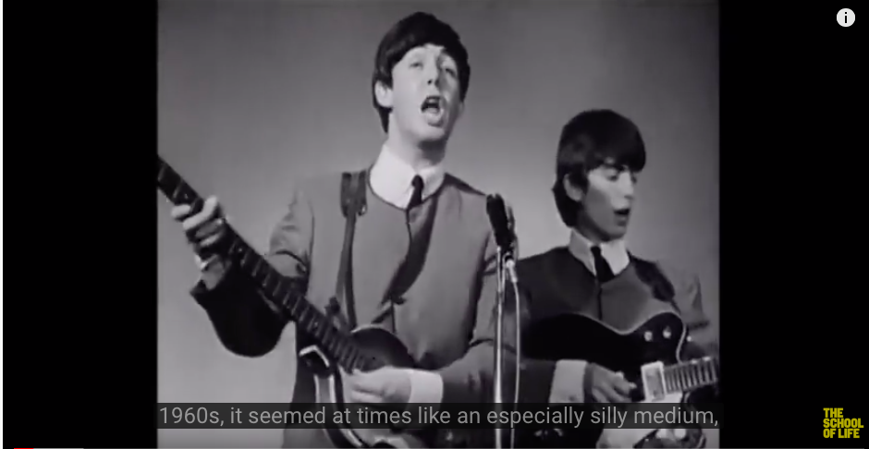
https://www.youtube.com/watch?v=9ypg71Aixwc

Slide 3
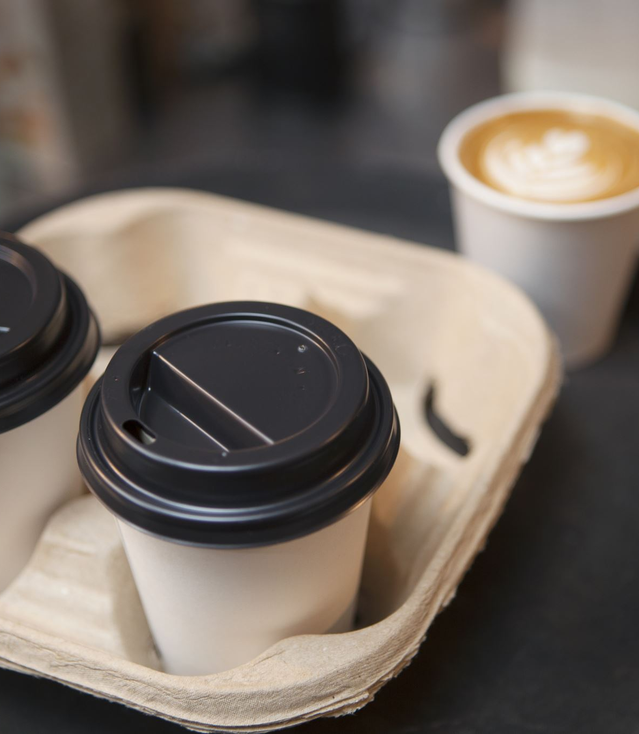
Let’s talk about our popular culture?

Slide 4
Selfie?

Slide 5
This link may cause an emotion reaction, it refers to the project that draws public attention to inappropriate selfies in the Holocaust memorial sites.
https://www.demilked.com/holocaust-memorial-selfies-yolocaust-shahak-shapira/
Project: https://yolocaust.de

Slide 6
On Selfies:
https://www.ncbi.nlm.nih.gov/pmc/articles/PMC5239793/
And
https://www.versobooks.com/blogs/4321-the-selfie-and-the-self-in-defence-of-duckface
Simon Blackburn (the RSA): https://www.youtube.com/watch?v=9c0pi0vT-qU

Slide 7
Your motivations of taking selfies:
Look through last 10 selfies you have taken: what is the span of time?
Why do you taken them: is the a pattern? For Instagram? For letting friend know you have changes something? You are bored? You look especially good?
Analyse your own motivations and try to see if your motivations are part of the popular culture that surround you, or you are working in your own individual contexts?
Group work: 1 hour.

