Slide 1
(Over)securitized Public Space
Joanna Rajkowska’s Engagement in Art Discourse
By Ula Chowaniec/ 2020

Slide 2
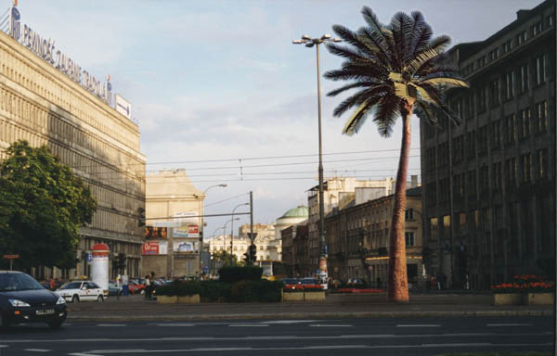
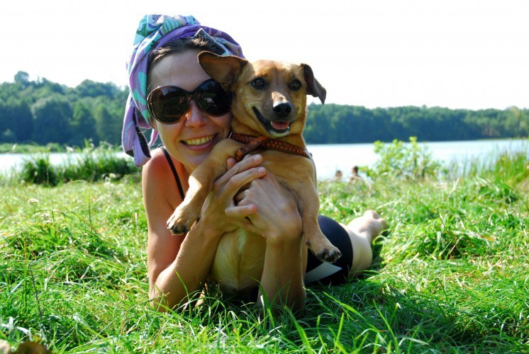
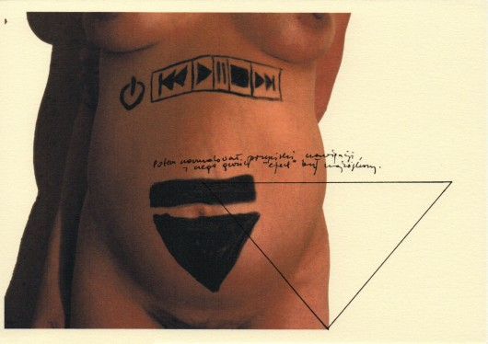
Joanna Rajkowska, Polish contemporary artist, author of numerous installations, artistic actions and artistic interventions, faces the paradox between cultural critical approach and societal need of security in many of her productions.

Slide 3
Basics of experience of the contemporary viewer in relation to interpretative and physical security
Secularized (derived from the “security” of/against metaphysics);
Homeless (migrant vagabond) – deprived from the roots, from the security of belonging;
Free in interpretation of art – away from security of iconic reading;
Free in the approach to the human body – the notion of abjection, the human body is not secured by its sacredness.
Physically – the viewer is safe/security if granted (public space)

Slide 4
Paradox
Lack of “security” (freedom) in interpretation of art in narratives is confronted in the Western world with constant control and security (the airport security, museum security, event search of the insecure adventure in the far East is a metaphor of over- securitization of the West)
Security in the Western public space exposes:
Distrust of the other people – the notion of potential danger from the other’s hatred of the unpredictable (consequence of the modern idea of progress as a foreseen development)

Slide 5
The artists themselves face the very paradox of contemporary cultural discourses versus the idea of good living (secure, cleaner, easier, freer)
Greetings from Jerusalem Avenue http://www.rajkowska.com/en/najslynniejsza-palma-w-polsce-usycha/
Umea Volcano http://www.rajkowska.com/en/wulkan-umea/
Born in Berlin http://www.rajkowska.com/en/miastobagno/

Slide 6
Main ideas/Problems/ for the artists/curators:
Security as a vehicle of control
Control as a deprivation of possibility of “artistic experience”

Slide 7
Rajkowska’s vision of contemporaneity seem to be a chain of increasing control and shrinking public space
The notion of the failed projects as footnotes to contemporary world:
Security restricts the possibility of artistic experience and through this
Securitisation restricts the possibility of measurement of “good life” and our freedom in fact
The freedom from danger may results, Joanna Rajkowska suggests, in constructing a numb society – indifferent to the phenomena of actual violence/oppression for the sake of security

Slide 8
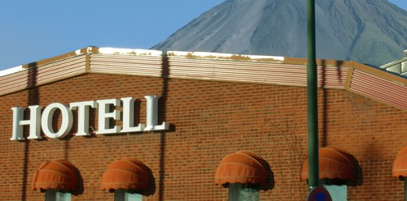
In Search of Public Space?
http://www.rajkowska.com/en/where-the-beast-is-buried/
Seminar and discussion on the role of Public Space (Joanna Rajkowska, Martine Rouleau, Maggie Humm, Katarzyna Depta Garapich, Urszula Chownaiec nad Kinga Stańczuk)
See: https://www.youtube.com/watch?v=11yQcetPjZk

Slide 9
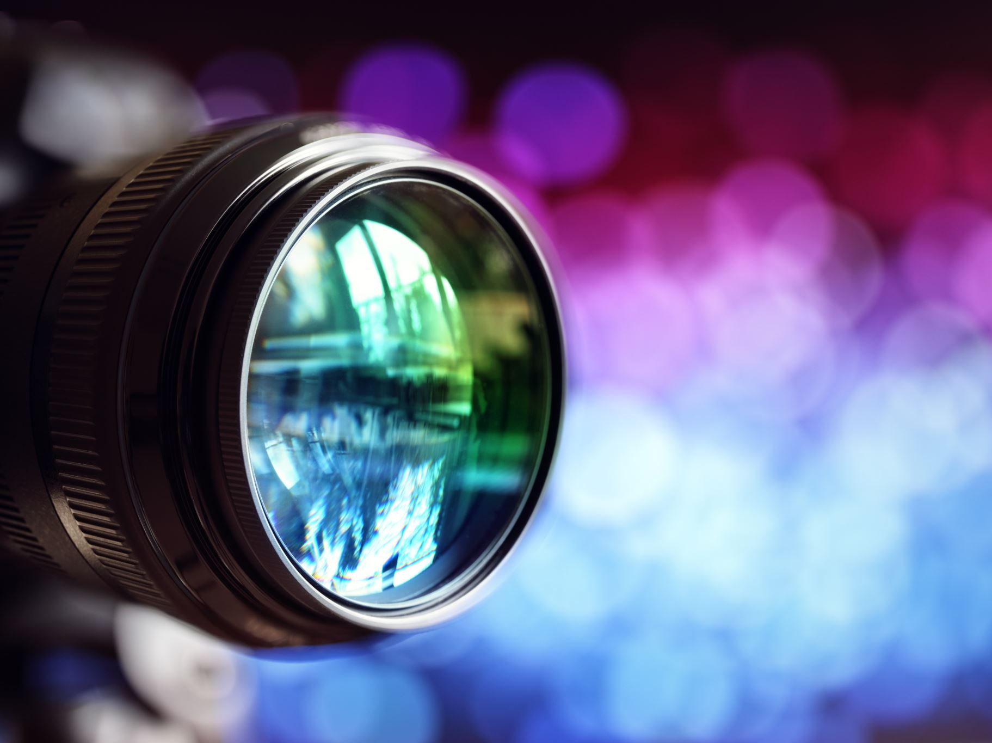
Go to the museum? (online?) collaborative experience in Hervrutah partner and debate
See it as a text/space of control
How are you controlled?
How are you “made” to be a good spectators?
How is the art controlled?
How is controlled the experienced?

