Slide 1
Intro to Cultural studies: Sapir-Whorf, Psychoanalysis, Theory of the Sign
We seldom realize, for example that our most private thoughts and emotions are not actually our own. For we think in terms of languages and images which we did not invent, but which were given to us by our society ― Alan Watts, British philosopher

Slide 2
LOVE/ MIłość

Slide 5
War/ wojna

Slide 8
An Orphan/ sierota

Slide 11
krig מלחמה

Slide 12
By also:
Lagom
And what about:
Twiticule : “Clara thought the #sad hashtag attached to her article’s link meant people were sharing pain about her failed roof garden, until she realized it was twiticule meant to break the news that her entire life was really lame.”

Slide 13
Also grammar…
We were there together…
Byliśmy tam razem….
Byłyśmy tam razem…

Slide 14
Alan Watts, British philosopher
We seldom realize …. that our most private thoughts and emotions are not actually our own. For we think in terms of languages and images which we did not invent, but which were given to us by our society

Slide 15
Sapir-Whorf Hypothesis https://www.youtube.com/watch?v=tFMo3UJ4B4g

Slide 16
Sapir-Whorf Hypothesis: linguistic relativity
The strong version says that language determines thought and that linguistic categories limit and determine cognitive categories.
The weak version says that linguistic categories and usage only influence thought and decisions.
About Arrival:
While the specifics of the Sapir-Whorf theory are still viciously argued today, Goddard says that the film offers a thought-provoking example of how integral language is to our lives—and yet how little we know about how it works, even today. “It’s not really about aliens,” as Goddard puts it. “It’s about us.”
https://www.smithsonianmag.com/science-nature/does-century-old-linguistic-hypothesis-center-film-arrival-have-any-merit-180961284/

Slide 17
Psychoanalysis in cultural studies
Jokes
Sayings
Understanding things
Songs
Theatre
Art
Literature
Medical studies
Life style
https://www.youtube.com/watch?v=ocMOJXkz9eI

Slide 18
Sigmund Freud
(born 6 May 1856, d. 23 September, 1939)
an Austrian neurologist and the founder of psychoanalysis, a clinical method for treating psychopathology through dialogue between a patient and a psychoanalyst.

Slide 19
What is psychoanalysis?
Terapią, leczeniem, związana z psychicznymi stanami człowieka.
Powstała pod koniec 19th wieku, młody lekarz Zygmund Freud (1856-1939) we współpracy z Józefem Breuerem pracuje nad histeriami kobiecymi o odkrywa, że pod wpływem hipnozy pacjentka Anna O (Berta von Pappenheim) opowiada o przyczynach powstania urazów.
Mówienie zmniejsza neurozy — Breuer uznaje, że „talking cure” jest skuteczną terapią.
Skoro mowa jest oczyszczająca, zatem literatura także ma cechy katartyczne.
Objaśnienie marzeń sennych (1900) S. Freuda to exempla wyjaśnienia stanów neurotycznych.
Opowiadania psychoanalityczne wykorzystuje przyjemność opowiadania tak, aby poprzez interpretację dojść do sedna problemu. Pierwsza interpretacja jest zawsze od pacjenta, druga — właściwa — od lekarza.

Slide 20
the patient constitutes their story by speaking/talking
The overriding principle is to strive to satisfy the lack of insatiable love: "A man is addicted to the basic rule governing the mental life, which is avoiding the annoyance associated with the lack of satisfying the love energy" (principle of pleasure, Lustprinzip)
This is how you can explain social life, culture, religion: the principle of sublimation, or the transfer of libido, not to a sexual object but its equivalent
Psychoanalysis - interpretation-oriented clinical therapy, as well as hermeneutics of the human psyche, in which both the patient and the physician are interpreters. It can also be a theory of the creative process.

Slide 21
The beginnings:
In 1893, along with Josef Breuer, he published an introductory report, and in 1895 book on hysteria;
in which he described 18 cases of patients in whom the occurrence of hysteria was associated with memories of sexual abuse in childhood The authors state that the hysterics suffer from memories.
The creator of psychoanalysis noted that in normal conditions strong emotional arousal requires proper discharging in the form of action (e.g. resentment from a person requires retaliation) or intellectual development. The memory of such arousal gradually loses on clarity.

Slide 22
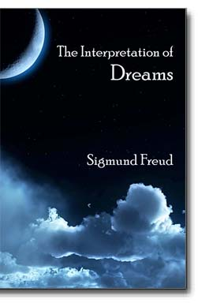
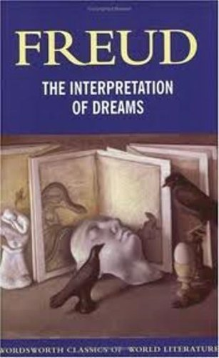
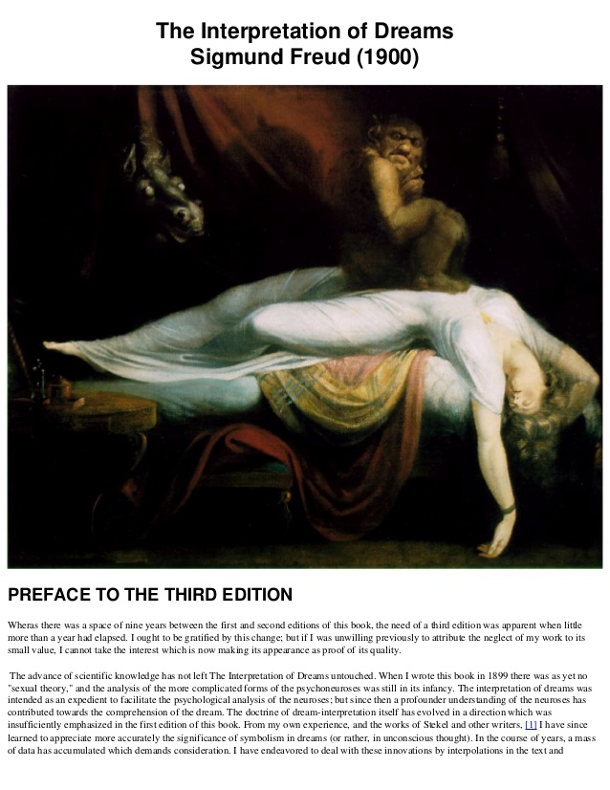
The basis of psychoanalysis:
(1899) The Interpretations of Dreams – Freud’s most important work; the book was post-printed - the title page says 1900. From the fact that it will be the founding of the psychoanalytic theory

Slide 23
Human’s Psyche:
das Es (Id, To) - it corresponds more or less to the unconscious, it is a huge reservoir of drive, it is indomitable chaos, without an organization,
das Ich (Ego, I) - is an intellectual element, a mediator between impulses and social rules and regulations, the their opposition of Id and Ego knows the difference between reason and passions,
Über-ich (Superego, Nad-ja) - it's an internalisation of bans and commands, it's an instance of conscience, religious rules, family, society (rights, duties),

Slide 25
The Interpretation of dreams:
Dreaming is a hidden thought clothed in a specific form. The hidden content pf the consciousness is only available via dreams;
"Sleep is an unconscious fulfilment of a wish that has been repressed and censored"
To interpret is to find a hidden thought, or unconscious nucleus, which is processed in a dream (workings of the dream)
"The work of a dream is analogous to the creation of a literary text: the threads of association do not run straight from the thought to the content of the dream, but often cross and intertwine along the way"
Dream topology is a system of transformations such as: condensation, like a metaphor, shifts, substitution, metonymy, imagery, secondary transformation of images;
We will see it in the “Spellbound” (1945 Hitchcock film)

Slide 26
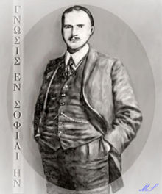
Carl Gustav Jung (1875-1961):
The theory of archetypes
Collective unconsciousness

Slide 27
Jacques-Marie-Émile Lacan
Jacques Marie Émile Lacan was a French psychoanalyst and psychiatrist who has been called "the most controversial psycho-analyst since Freud".
The Imaginary
The Symbolic
The Real

Slide 28
https://www.youtube.com/watch?v=uM2FGc0wDg8

Slide 29
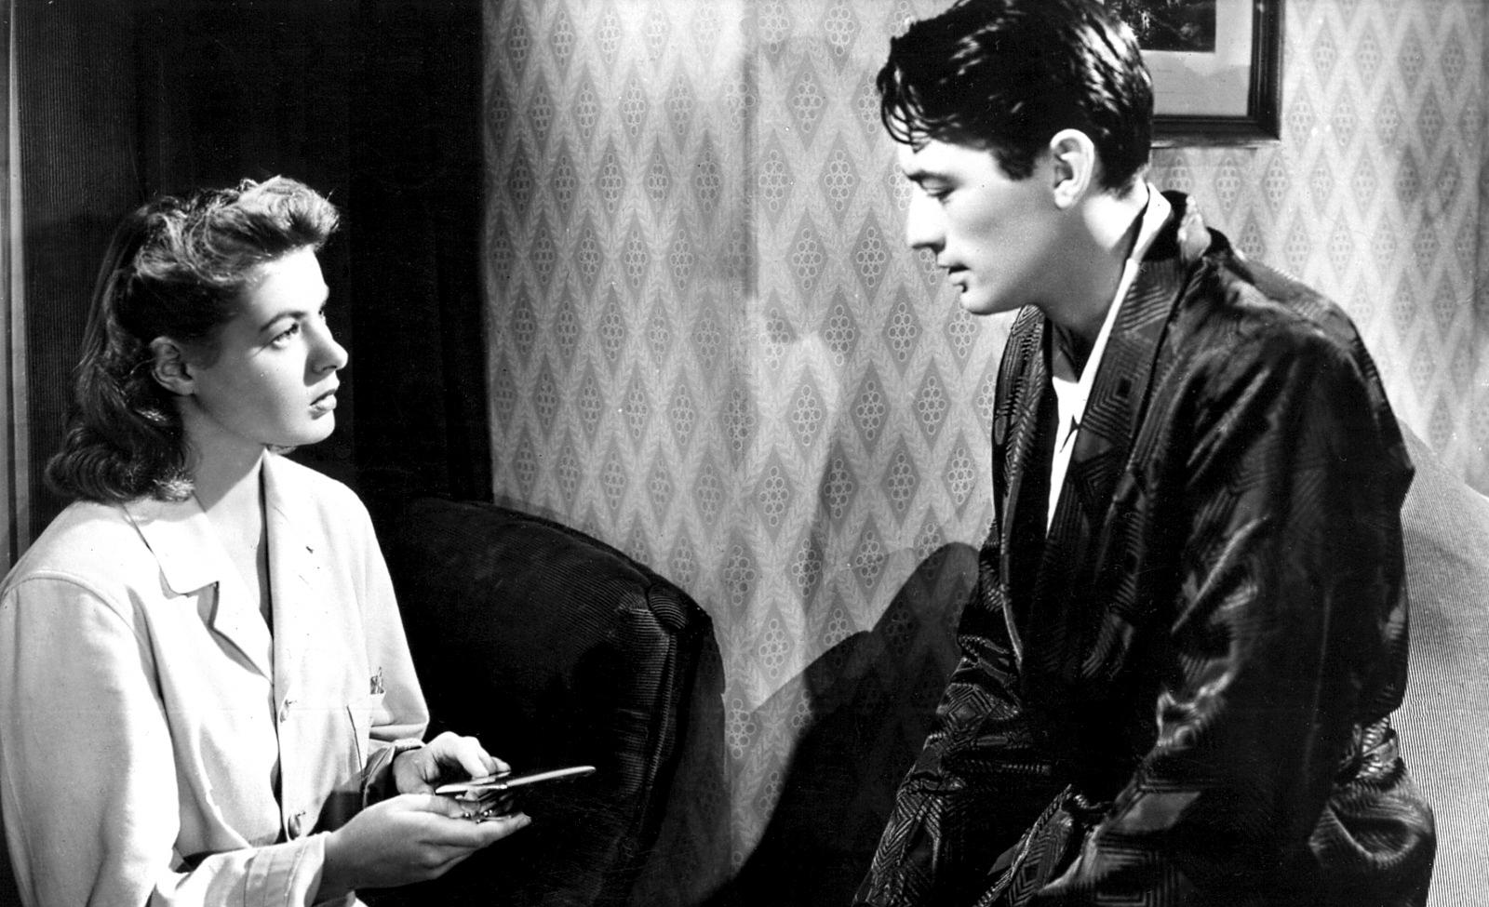
Spellbound (1945) https://www.youtube.com/watch?v=Qku4jtvtay8

Slide 30
How does the film uses the psychoanalytical theory?
Choose a fragment of the film?
Analyse it from the psychoanalytical point of view
How this cinematic representation of human psychology uses the psychoanalysis as a theory?
300-350 words

Slide 31
Next…
Structuralism
Language
Poststructuralism

