Slide 1
Introduction to Cultural Studies
Prof. Urszula Chowaniec
u.chowaniec@gmail.com

Slide 2
What is it? What will you learn?
This course engages both the theory and the practice of cultural studies as it began to take shape in university media studies programs in the 1970s, first in Britain, and eventually in the U.S.
The course reviews the basic concepts that inform the cultural studies approach: ideology, semiotics, race and ethnicity, gender, resistance, and others.
It also looks at how cultural studies changed the way scholars saw popular media. Rather than reject mass culture outright, the cultural studies approach sought to appreciate popular culture as the expression of everyday consciousness and even as a site of cultural resistance.
The course thus is not about intercultural communication nor about studying other cultures. It instead is about a movement that gained momentum in the 1970s, took popular culture seriously instead of dismissing it outright, and influenced how an entire generation of scholars discussed and looked at popular film, television, music, and other cultural forms.
Course Goals and Objectives: This course introduces a historical overview of the cultural studies approach, with a special emphasis on the relevance of this approach to understanding media and popular culture
Learning Objectives: By the end of the course, you should be able to
Analyze and explain major theories that both influenced and came out of cultural studies and its approach to popular culture
Apply one or more concepts of cultural studies to a unique research problem that you know well, and that you have identified and described on your own
Demonstrate the practicality of cultural studies theory to new situations and practices relevant to your everyday experience
Synthesize two or more major cultural studies theories to demonstrate a new insight into media and popular culture

Slide 3
Main Themes
1. What is culture?
2. Psychoanalysis
3. Marxism
4. Structuralism
5. Gender and sexuality
6. Race and post-colonialism
7. Postmodernism

Slide 4
How will you be assessed?
After class assignments: elaborate on the questions, ideally refer to some critical sources, make your argument well-argued, make your text well-structured. Minimum 4 assignment to be assessed
Assessment (final mark): 1. Presence record (at least 80 percent); 2. Assignments 3. Oral examination about the materials/themes discussed during the class.

Slide 5
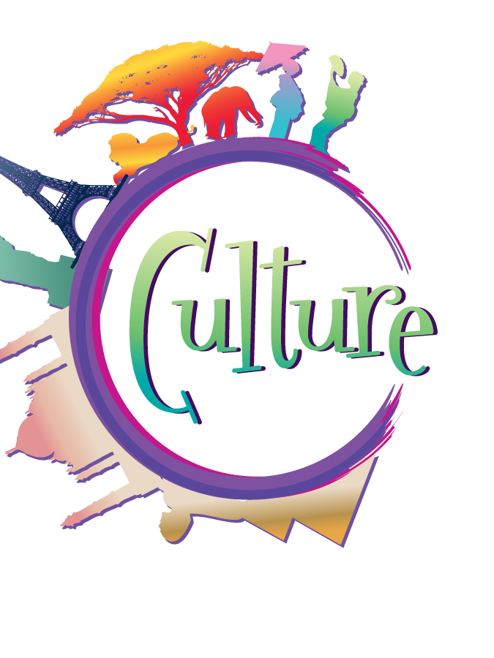
Culture?

Slide 6
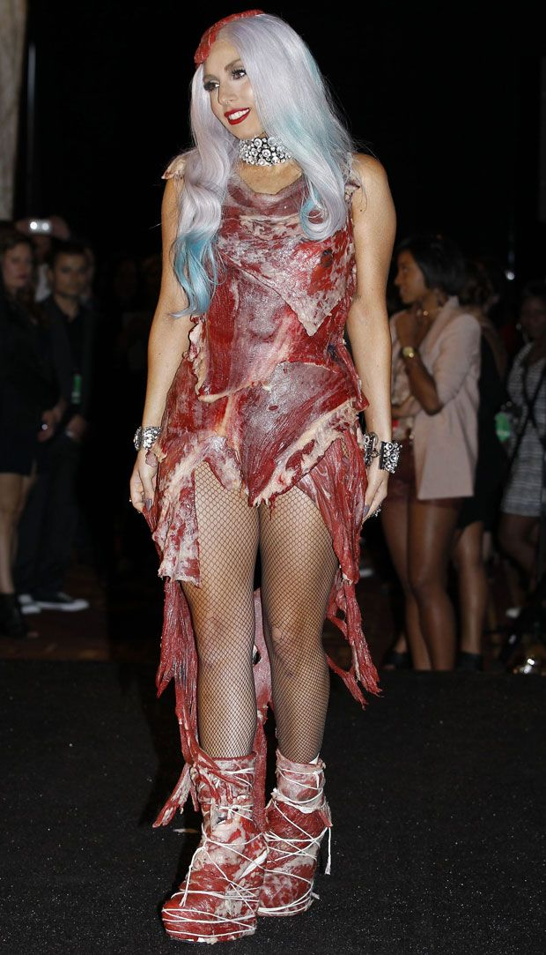
LADY GAGA
At Ellen’s:
https://www.youtube.com/watch?v=Kk0M54MPEqg
And Bad Romance
https://www.youtube.com/watch?v=qrO4YZeyl0I

Slide 7
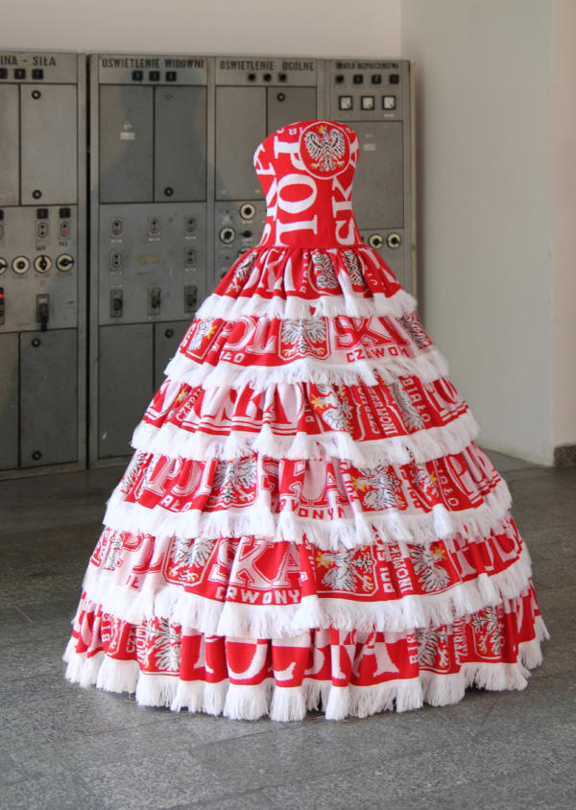
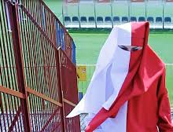
Polski, Patriotki, Rebeliantki Poznań 2017
https://www.youtube.com/watch?v=Kk0M54MPEqg (a review, in Polish)

Slide 8
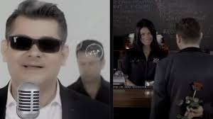
Disco POLO
https://www.youtube.com/watch?v=Kk0M54MPEqg

Slide 9
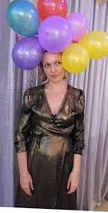
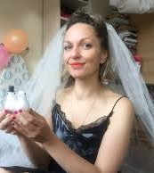
Disco Polo/Żubr/Polish culture… https://medium.com/@voilafest/interview-wesele-wedding-4707e6c9f633

Slide 10
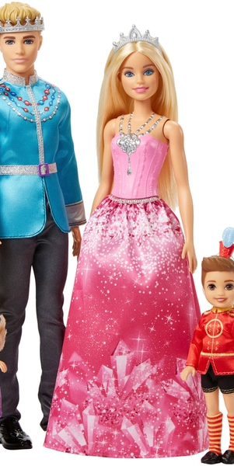
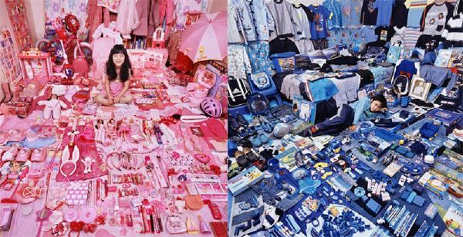
Pink for girls, blue for boys?

Slide 11
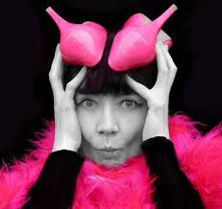
Iwona Demko

Slide 12
Introduction to Cultural Studies
What is culture?
What is right and wrong in the culture?
How to assess it?
High/low?
Elitist/kitch
Meinstream/specialized

Slide 13
Definitions:
1. „general process of intellectual, spiritual and aesthetic development” (Raymond Williams, for example Western Europe);
2. „a particular way of life, whether of a people, a period, or a group „ (Raymond Williams), e.g. Culture of holiday making
3. „works and practice of intellectual and especially artistic activity” (Raymond Williams) – signifying practices, effects of activities
Popular culture is 2 or 3, but cannot be 1?

Slide 14
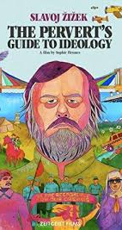
Ideaology
An ideology is a collection of normative beliefs and values that an individual or group holds for other than purely epistemic reasons. The term is especially used to describe a system of ideas and ideals which forms the basis of economic or political theory and policy.

Slide 15
One culture or cultures? https://www.youtube.com/watch?v=RV50AV7-Iwc
Prepare the answers to the following questions: 1. Is there a point to discuss culture in singular term? 2. Who decide about what is a mainstream culture? 3. the term "melting pot"? What is it? What do you think of it? 4. How do we judge other culture? What's ethnocentrism? 5. What's counterculture? 6. What's cultural diffusion? 7. What is symbolic interactionism? 8. Explain the relationship between cultural functionalism and conflict theory?

