Slide 1
Hannah Arendt (1906-1975)
A political theorist, a long-time refugee, a rather traditionalist as it comes to feminism and a teacher of thinking

Slide 2
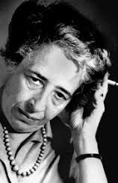
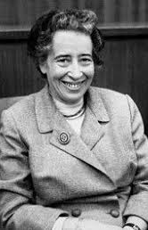
Hannah Arendt (1906–1975)
political theorist
of a German-Jewish family
forced to leave Germany in 1933
lived in Paris
in 1941 she immigrated to the United States

Slide 3
Things to see/hear/read
Hannah Arendt (film 2012): directed by Margarethe von Trotta and starring Barbara Sukowa
BBC Radio 4 In Our Time (Hannah Arendt: Conversation, podcast: https://www.bbc.co.uk/programmes/b08c2ljg)
Interview with Hannah Arendt 1964 interview with Günter Gaus (Portable Hannah Arendt, ed. by Peter Baehr, 2003)
2018: Why Read Hannah Arendt Now? by Richard J. Bernstein (NY: Penguin Books)
And some 304000 entries in Google Scholar search ☺
The Gender-Neutral Feminism of Hannah Arendt Author(s): KIMBERLY MASLIN Source: Hypatia, Vol. 28, No. 3 (SUMMER 2013), pp. 585-601
Also:
Julia Kristeva’s Le Génie Féminin: Hannah Arendt.
Judith Bulter’s lecture: Hannah Arendt, Ethics and Responsibility https://www.youtube.com/watch?v=vOwdsO6KkkI

Slide 4
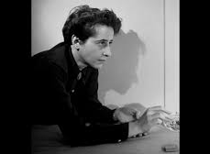
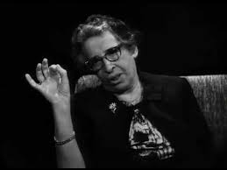
the central ideas of Arendt's thought (among others):
THE SOCIAL
FREEDOM
POWER
JUDGEMENT
FORGIVENESS
UNDERSTANDING
ACTION
EVIL

Slide 5
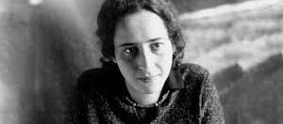
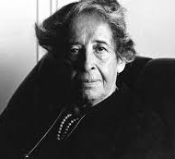
She is best known for two works: The first, The Origins of Totalitarianism, published in 1951 The second, The Human Condition, published in 1958;

Slide 6
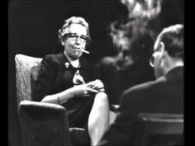
In the popular knowledge best known for her:
Eichmann in Jerusalem: A Report on the Banality of Evil. New York: Viking Press, 1963.

Slide 7
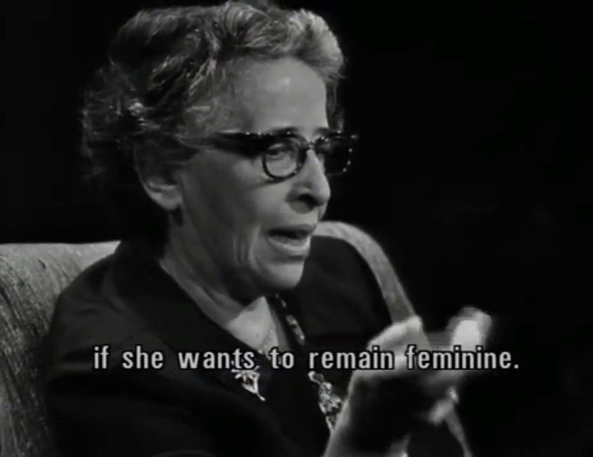
Woman’s emancipation?
She rarely addresses the question of position of women in society. Two “occasions” are the character of directed engagement with the matter:
From the essay/review “On the Emancipation of Women” 1933 and
1964 interview with Günter Gaus , when she admitted not to be ever seriously interested in the issue.

Slide 8
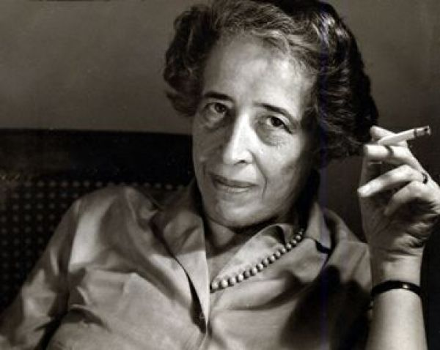
The feminist argument
Yet, the contemporary feminist critics try to reclaim the works and ways of thinking of a human being for the feminist, women-centered and gender perspectives.
This argument includes:
Reference to the notion of understanding in Arendt’s thought
Making connection to the notion of women’s independence, right to solitude (Virginia Woolf)
Consideration of the notion of a Jew as a pariah and making the parallel with a notion of a woman (historically with no rights)
Making a comparison with the women’s second movement of reclaiming the women’s position with its “difference” and not necessarily only sameness yet with the identical rights and duties of understanding – owning the position of pariah.

Slide 9
Understanding….
From the essays “Understanding and Politics (the difficulties in understanding)” 1954

Slide 10
Love and Hannah Arendt
Have a look at the subsequent slides and try to understands the Arendt’s “aphorism” and her understanding of love?
Is it important?
Does literature give us the legitimacy of love?
What’s important about love

Slide 11
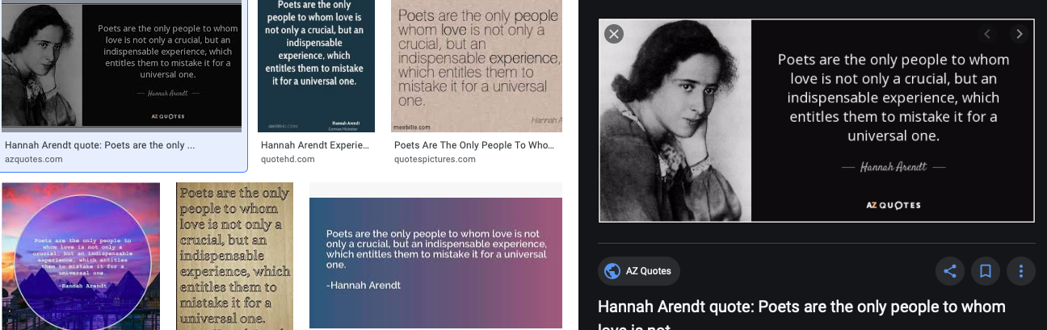
Example of Hannah Arendt’s - becoming an icon/source of aphorisms , yet… be careful and check the sources!

Slide 12
1. Poet’s are the only one, but love is important
2. Love is primarily for us a mere “romance” digested through poetic experience – we are fooled (Madame Bovary)
3. But some of us are blessed to experience it hence ….. (next slide)

Slide 13
For love, although it is one of the rarest occurrences in human lives, indeed possesses an unequalled power of self-revelation and an unequalled clarity of vision for the disclosure of who, precisely because it is unconcerned to the point of total unworldliness with what the loved person may be, with his qualities and shortcomings no less than with his achievements, failings, and transgressions. Love, by reason of passion, destroys the in-between which relates us to and separates us from others..

