Slide 1
The “Optimistic turn” of the 1990s/2000s and war against gender
The story how women are made guilty again….

Slide 3
1990s: implementation of gender studies, language of equality, and social awareness of equality politics, body politics and LGBTQ issues.
2001 - A Government Plenipotentiary for the Equal Status of Women and Men is established by the Ordinance of the Council of Ministers. Izabela Jaruga-Nowacka is appointed to the position of the plenipotentiary. 2004 – Magdalena Środa the government's plenipotentiary for equality between women and men.
2003 Let them see us!
2005 - Magdalena Środa was dismissed from the post of plenipotentiary by Prime Minister Kazimierz Marcinkiewicz on November 4, 2005. The tasks previously carried out by the plenipotentiary were handed over to the Ministry of Labor and Social Policy.

Slide 5
Magdalena Środa
In December 2004 there was a controversy over Środa's statement during an international conference on honour killings in Stockholm. When asked about the situation in Poland, she told Reuters: "Catholicism does not directly support or oppose violence against women. But there are indirect links through culture which is strongly based on religion

Slide 6
Literary phenomena
Izabela Filipiak/Morska in 1990s
The themes of motherhood and the body deconstructed
The writing of the disappointed (e.g. Nic by Bieńkowski, Zwał by Shuty and Małż by Dzido)
Gay and Lesbian literature

Slide 7
Lesbian literature
Ewa Schilling tells partially naïve love story: a relationship between a teacher and a student, the catch is that it is a student who appears to be a a grown-up and reasonable woman, while the teacher is a romantic dreamer longing for an ideal love…
Many themes included:
Religion and homosexuality;
School and homosexuality;
Acceptance by parents and the peer groups

Slide 8
Michał Witkowski, Lubiewo/Lovetown
Growing up queer in a Communist state, queens Patricia and Lucretia spent the '70s and '80s underground, finding glamour in the squalor, strutting their stuff in parks and public toilets, seducing hard Soviet soldiers, preying on drunks and seeing their friends die of Aids. Today they're about to hit Lovetown, a homo-haven, populated by a younger generation of emancipated gays, who are out and proud in their post-Communist paradise: suntanned, sculpted and vigorously spending the pink euro. This is the story of the clash between old and new gays - the clapped out queens and the flashy fags - as they meet in a place where anything goes, but some things have also been lost.

Slide 9
And yet, Gender still appear to be a scary term
Monstrous Gender

Slide 10
Why monstrous?
Monstrous Gender
Izabela Filipiak/Morska
Rough translation: Are we, in those dresses, ok with our gender?

Slide 11
Feminist Language “used” for creating an enemy
Ks. Dariusz Oko and the debate on gender in the Catholic Weekly
The Catholic Church Versus Feminists:
here: Polish Cardinals summit and
prof Magdalena Środa

Slide 12
Gender…
…. is a concept “deeply destructive” to “the person, inter-human relations and all social life,” we read in the pastoral letter by Polish bishops attacking the “ideology of gender,” which was read in all churches on December 29, 2013. In their letter, the bishops said the “ideology of gender” was “strongly rooted in Marxism and neo-Marxism” and had been promoted in Poland “for several months” by “vocal circles with considerable financial means” who wanted to “experiment on children.”

Slide 13
Monstrous gender
Against Human nature
rooted in Marxism?

Slide 14
Gender trouble
The history of the gender trouble in Polish Church goes back to 2012, at least this was suggested by the Polish Church’s Catholic Information Agency, KAI in January 2014, stating that the Catholic Church worldwide had “unanimously rejected the ideology of gender” after being warned about it by Pope Emeritus Benedict XVI in a December 2012 Christmas address to the Roman Curia.
See: http://www.crisismagazine.com/2012/benedict-defends-traditional-family-in-christmas-address-to-roman-curia

Slide 15
The letter to the Pope signed among other by the prof. Magdalena Środa to stop the false and unreasonable usage of gender by Polish Catholic Church was unsuccessful. The open answer seemed to convey the same assumption: there is gender ideology, genderism, gender lobbies and it is dangerous. There is no doubt that this is a rhetoric move: Catholic circles are fully aware of the gender as concept to study and describe social contexts and it is not against the doctrine as such (see Supplement of Tygodnik Powszechny). In December 2014: Tygodnik Powszechy, Sławomira Walczewska says: let’s stop fight against the word. Indeed, it might be a linguistic trick to stop the debate. Avoid the word gender. Once we exchange “gender” with a cultural role, it will be easier to swallow. But will it be enough? Or the need of enemy is stronger?

Slide 16
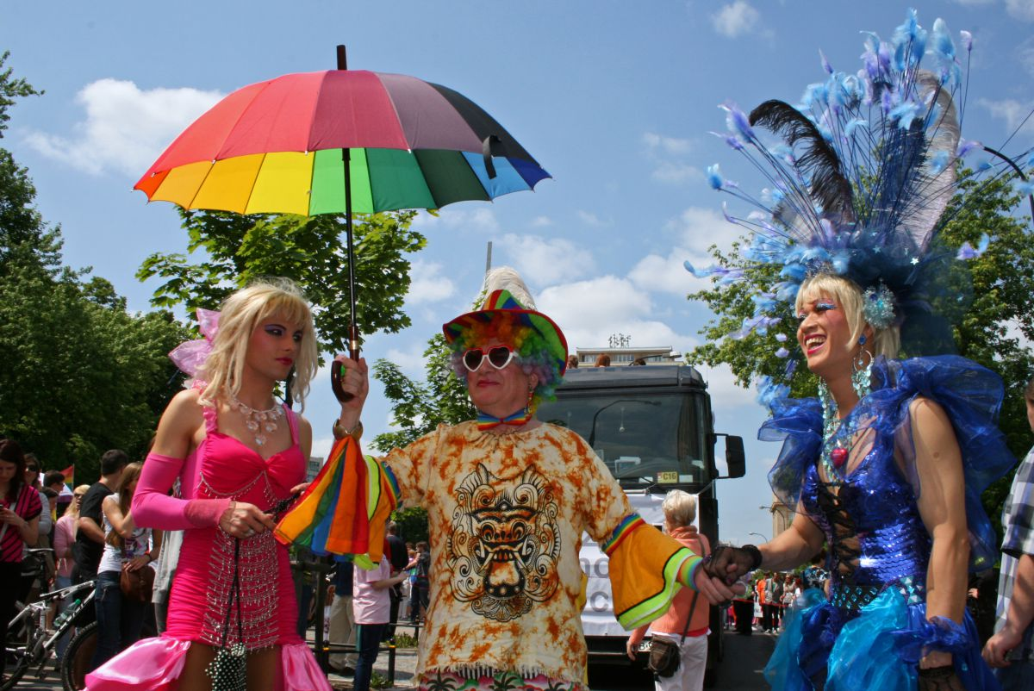
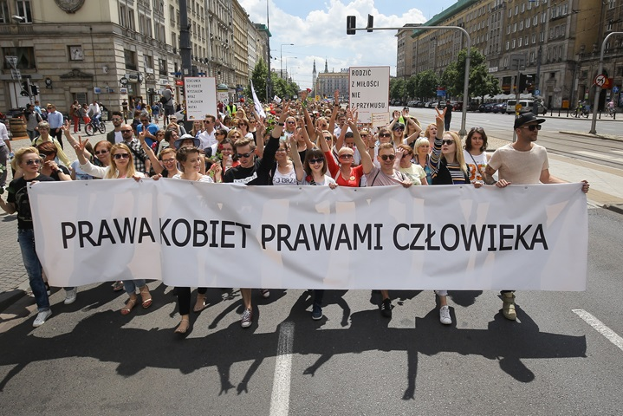
Gender has become an abstract enemy in a country where…
Polish women have to fight against ridiculous attempts to restrict already restrictive anti-abortion law
Equality Parade Warsaw June 11, 2016
For about 500 million people in the European Union only 75 million does not have access to civil unions and same-sex marriage. Half of these 75 million are Polish women and men.
Parade of Respect Warsaw June 18, 2016

Slide 17
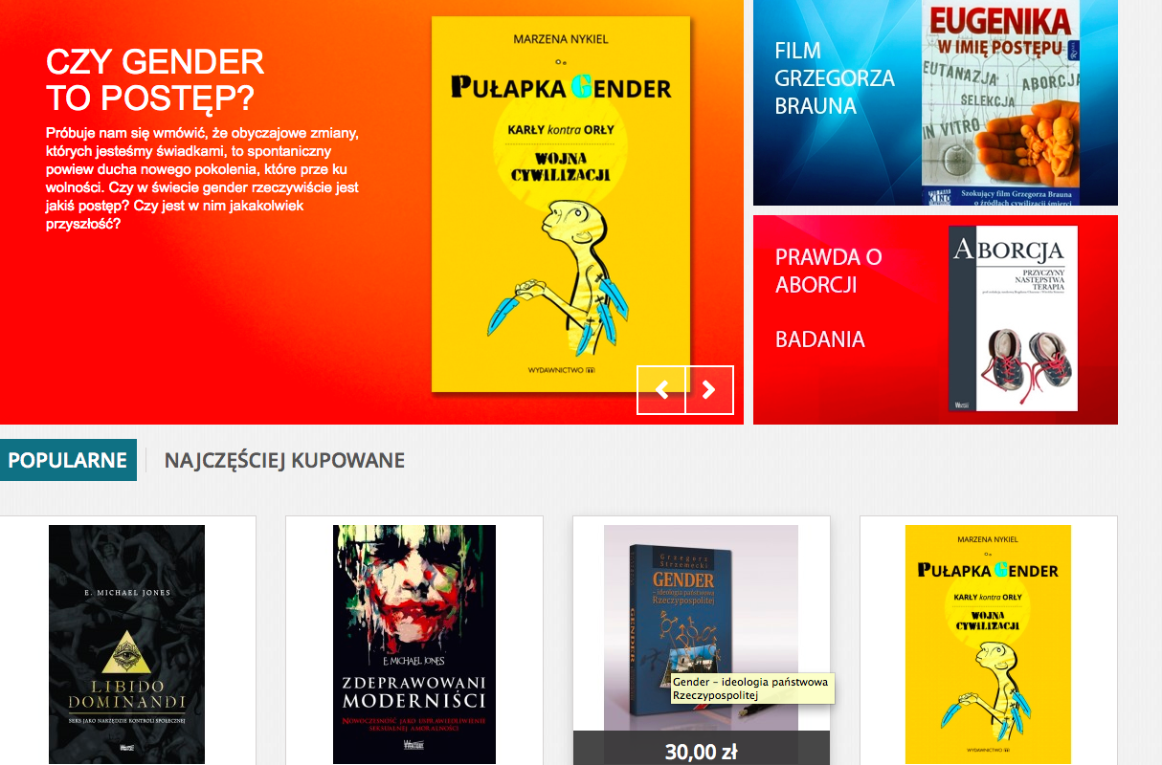
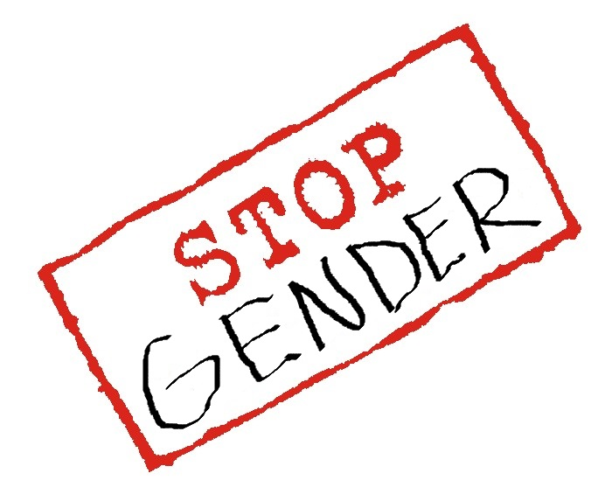
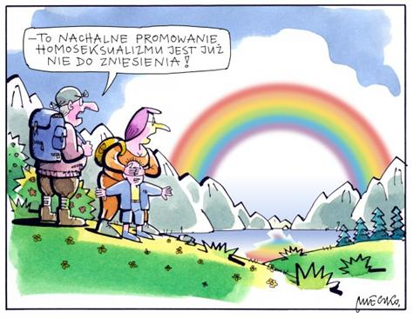
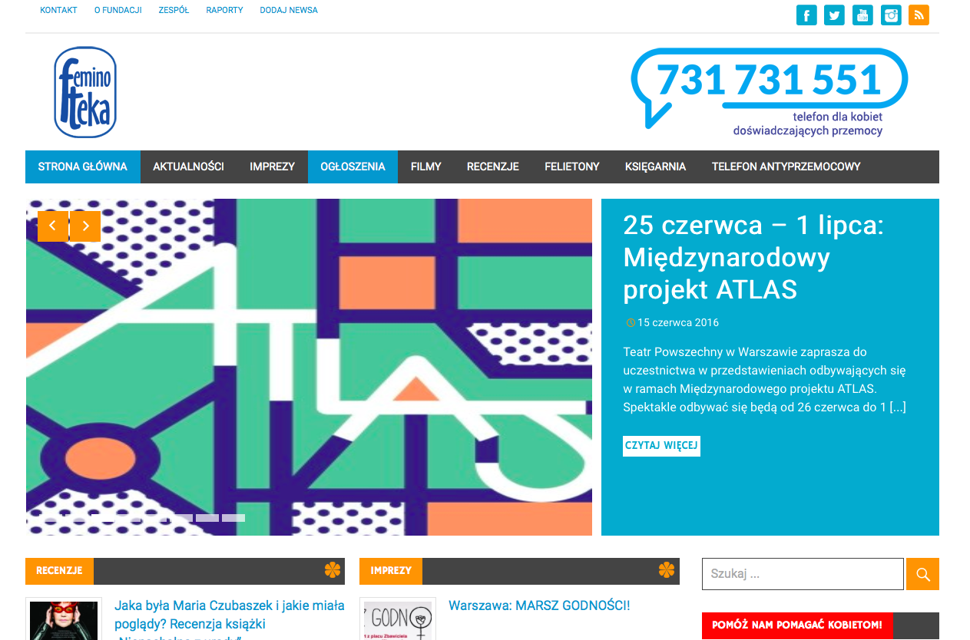
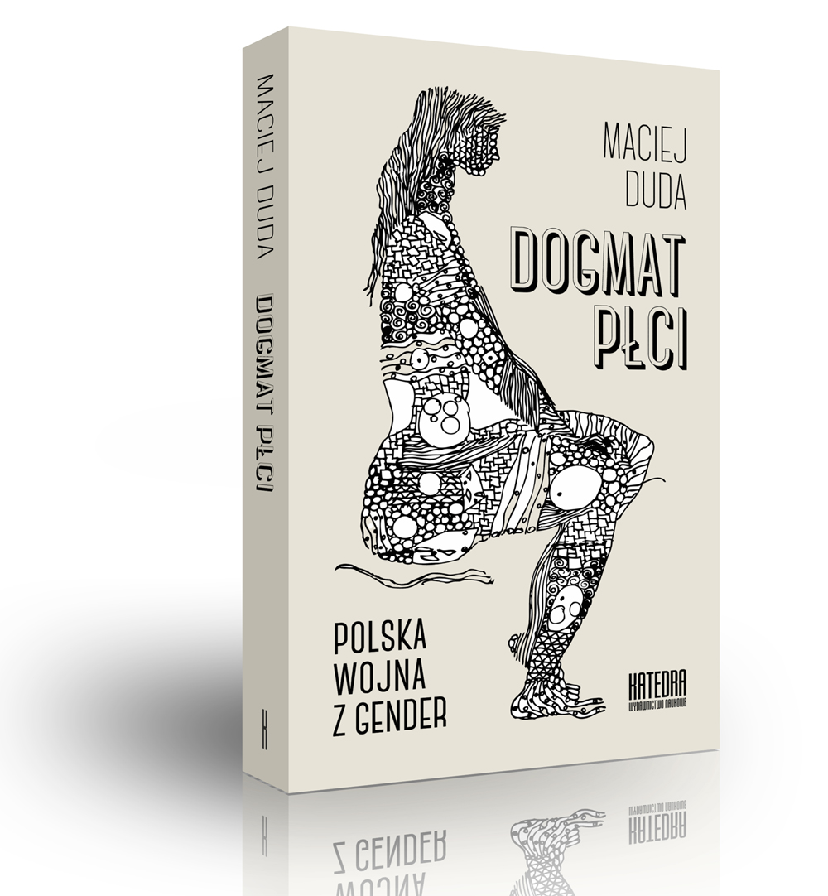
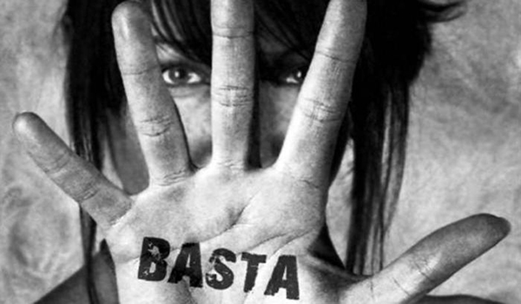
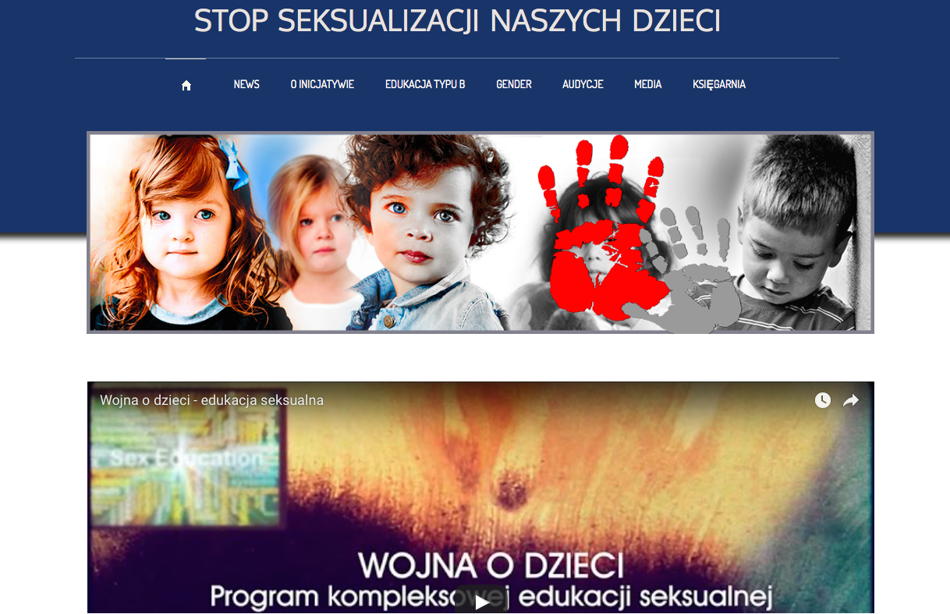
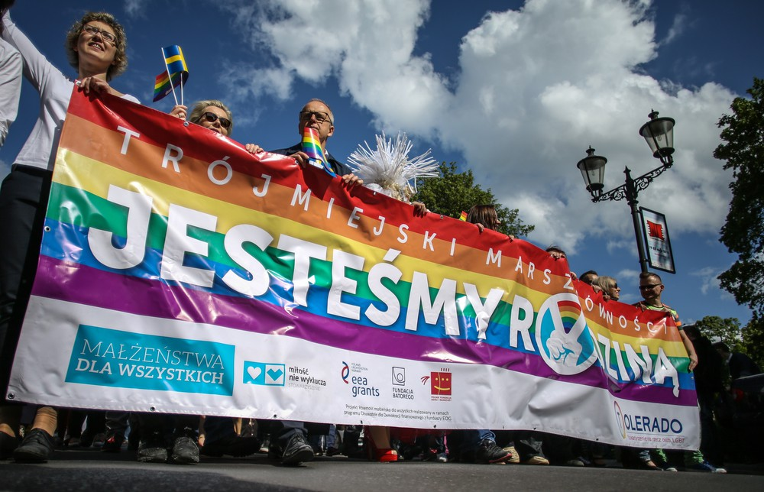
End of Gender?
Most likely the beginning….

