Slide 1
Culture and Ideology
Introduction to Cultural Studies,
Žižek and desire in cinema
Superman, mass literature, Louis Althuser, Pierre Bourdieu

Slide 2
Ideology…. again
An ideology is a collection of normative beliefs and values that an individual or group holds for other than purely epistemic reasons. The term is especially used to describe a system of ideas and ideals which forms the basis of economic or political theory and policy.

Slide 3
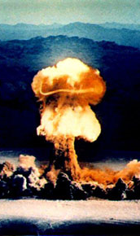
James Bond
in storytelling:
character and its construction, especially the protagonist;
narrative perspective;
often the projection of fears;

Slide 4
Eco Umberto (1932-2016)
The Myth of Superman
James Bond, Tarzan, Fantomas, Arsène Lupin, count Monte Christo.

Slide 5
The socialist time – other time of a superhuman
the ideological novel

Slide 6
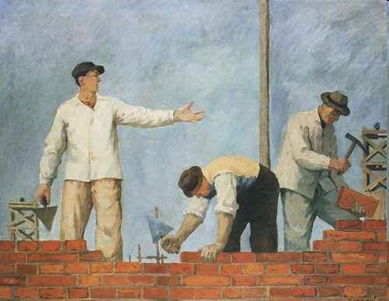

Slide 7
Louis Althusser
In Althusser's view, our values, desires, and preferences are inculcated in us by ideological practice, the sphere which has the defining property of constituting individuals as subjects. Ideological practice consists of an assortment of institutions called "ideological state apparatuses" (ISAs), which include the family, the media, religious organizations, and most importantly in capitalist societies, the education system, as well as the received ideas that they propagate. No single ISA produces in us the belief that we are self-conscious agents. Instead, we derive this belief in the course of learning what it is to be a daughter, a schoolchild, black, a steelworker, a councilor, and so forth.

Slide 8
Antonio Gramsci - Ideology & Hegemony
https://www.youtube.com/watch?v=-wEBAAt4xxw
According to Gramsci, hegemony (“predominance by consent”) is a condition in which a fundamental class exercises a political, intellectual, and moral role of leadership within a hegemonic system cemented by a common world-view or “organic ideology.”

Slide 9
Pierre-Félix Bourdieu
Habitus
Symbolic Capital
Cultural Capital
The fields of cultural construction
The habitus is acquired through imitation (mimesis) and is the reality in which individuals are socialized, which includes their individual experience and opportunities. Thus, the habitus represents the way group culture and personal history shape the body and the mind; as a result, it shapes present social actions of an individual

Slide 10
Slavoj Žižek (1949) Pervet’s Guide to Cinema
https://www.youtube.com/watch?v=t1ZUmIWDLYY
Slavoj Žižek is a Slovenian philosopher. He is a professor at the Institute for Sociology and Philosophy at the University of Ljubljana and international director of the Birkbeck Institute for the Humanities of the University of London
Žižek, Slavoj. The Sublime Object of Ideology. New York: Verso, 1989

Slide 11
Exercises: watch a film and analyse
Alfred Hitchcock
Spellbound (1955)
https://www.youtube.com/watch?v=xzuV-wVFg7E
What element of ideological standpoint can you point out?
How does it determine the plot?
What is the least probably in the storytelling? Is it ideological?

